Slide 1
儿童感染性疾病的微生物学诊断
郑晓天
2015

Slide 2
Challenges 挑战: emerging infectious diseases 新感染性疾病
Bacterial, fungal, parasitic, and viral infections
Zoonotic, food born, vector born, healthcare associated

Slide 3
Challenges: increasing antimicrobial resistance 耐药菌增多
Gram positives:
  MRSA, VRE, resistant pneumococcus
Gram negatives:
  ESBL, ampC, CRE, NDM

Slide 4
Challenges:
Changing healthcare environment
卫生健康系统
Provide best patient care by maximizing productivity while efficiently using limited resources
高效使用资源，提供优质医疗服务

Slide 5
Resistance and outcome
细菌耐药的结果
MRSA bacteremia 耐药金葡:
    significantly higher mortality rate than those caused by MSSA 死亡率明显高于敏感金葡. (Cosgrove et al. CID 2003)
    Appropriate empirical antibiotic treatment results in significant survival 合理抗生素治疗明显提高病人生存 (Paul et al. JAC 2010)
VRE bacteremia 耐万古霉素肠球菌:
    Increased mortality compared to VSE 死亡率明显高于敏感菌 (DiazGranados et al. CID 2005)

Slide 6
Resistance and outcome
细菌耐药的结果
ESBL bacteremia: significantly associated with increased mortality 死亡率显著增高 (OR, 3.6), length of stay 延长住院时间 (1.56 fold), delay in appropriate therapy 延缓合理治疗(OR, 25.1), and cost 增加经济负担.
  (Schwaber et al. AAC 2006)
Resistant organisms 耐药: are associated with higher hospital charges ($15,626 vs. $25,573), longer hosp stay, and significantly higher death rate
    (Neidell et al. CID 2012)

Slide 7
Early antimicrobial administration improves outcome
抗生素尽早使用提高疗效
Septic shock and hypotension 感染性休克: Survival rate if effective antimicrobial is received within 1 h = 79.9%; will decrease by 7.6% /h.
(Kumar et al, Crit Care Med 2006)
Bacteremic pneumococcal pneumonia 肺炎球菌肺炎: survival is associated with administration of antimicrobial therapy within 4 h （前4小时内，正确抗生素治疗影响存活）
(Garnacho-Montero et al, Scand J Infect Dis, 2010)

Slide 8
Perception of Microbiology Testing
Microbiology testing ≠ culture
Culture = identification + susceptibility?

Slide 9
Result turnaround times using standard methods
结果回报时间
Bacterial culture 细菌培养: 1-3 days
Mycobacterial culture 分支杆菌培养: 6-8 weeks
Fungal culture 真菌培养: 4 weeks
Virus culture 病毒培养: 2 weeks (2 days for shell vial culture)

Slide 10
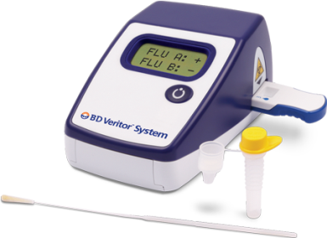
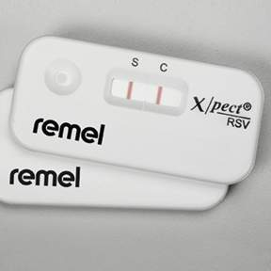
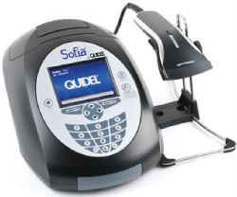
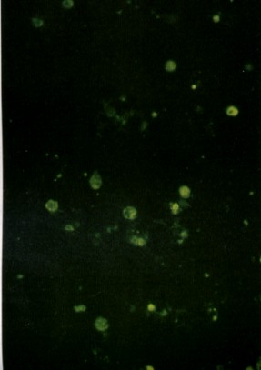
Rapid Microbial Detection
- Immunological methods
快速检测： 免疫学方法
Examples: Antigen detections such as lateral flow immunoassay, DFA, etc.
  Strengths: ease of use; reasonable cost; lab and POC; very fast
    简便，价格， 可用于实验室或POC
  Limitations: assay performance (limited sensitivity)
    敏感性

Slide 11
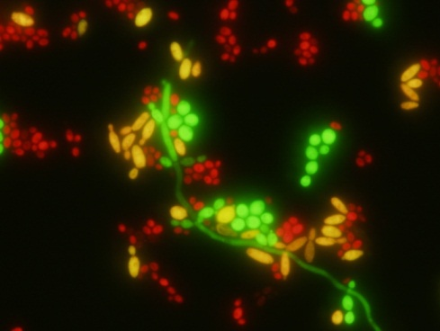
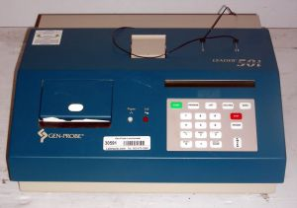
Rapid Microbial Detection
- Molecular methods
(non-amplified)
快速检测： 非扩增分子方法
Examples: AccuProbes; PNA FISH by DNA Probe Hybridization
  Strengths: relatively easy to start; no need for expensive instrument; result available in hours
    简易，仪器价格，数小时出结果
  Limitations: manual processing; most testing on cultures (not directly on samples)
    手工操作多，仍需培养

Slide 12
Rapid Microbial Detection
- Molecular methods (Amplification)
快速检测： 扩增分子方法
Examples: PCR; Loop Mediated Amplification (LAMP); helicase‐dependent amplification (HDA); transcriptase mediated amplification (TMA)
  Strengths: very sensitive and specific; assay availability; possible multiplexing; automation
    高敏感，特异，可为多重反应，自动化
  Limitations: most require instrumentation, cost
    需仪器，价格

Slide 13
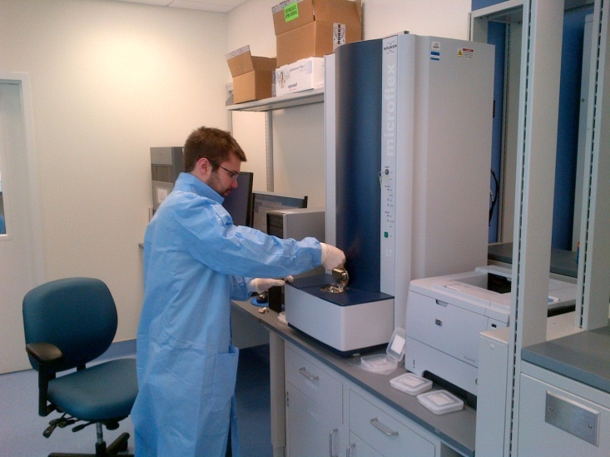
Rapid Microbial Detection
- Other technologies
Bacterial phage
MALDI-TOF

Slide 14
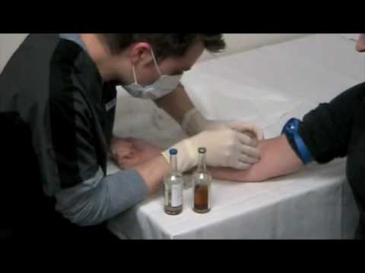
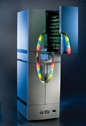
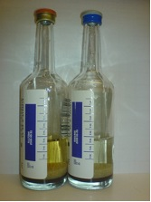
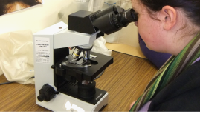
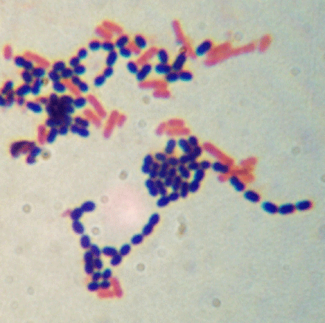
Blood culture processes
血培养
Blood draw → positive growth detected: 1-2 days (most)
Gram stain 革兰染色, subculture to plate medium 转种平板: 30 – 60 ’

Slide 15
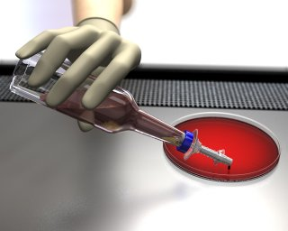
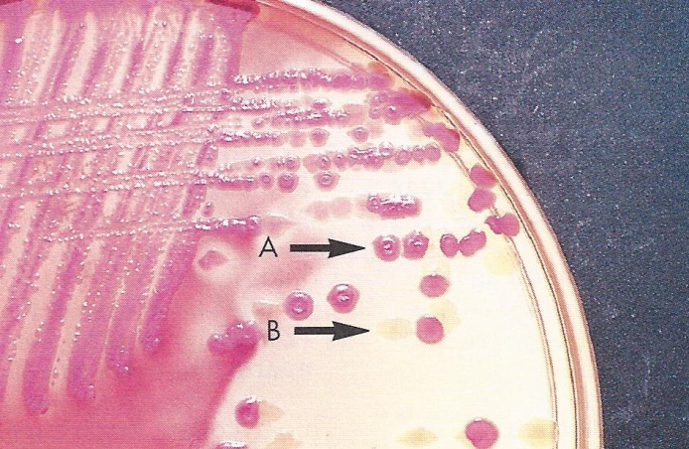
Blood culture
agar plate and incubate 平板孵育: 1 -2 days
Colony identification using biochemical reactions + testing of antibiotic susceptibility 菌落鉴定， 药敏: 1-2 days

Slide 16
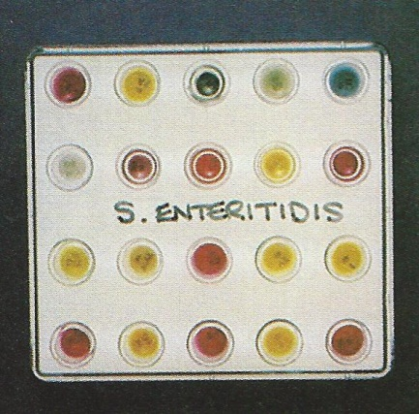
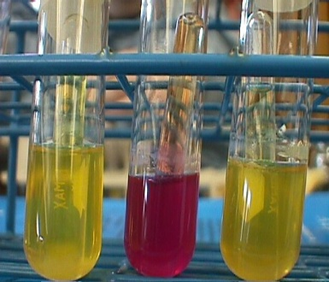
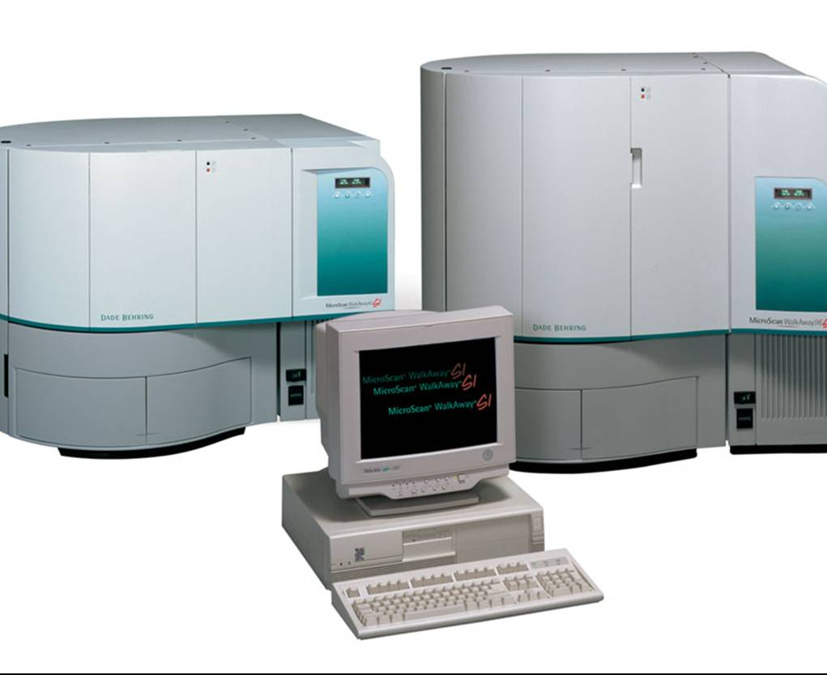
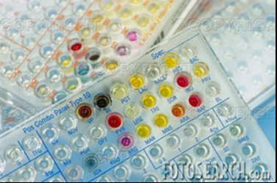
Phenotypic identification
Biochemical reaction profiles are compared to database for species identification

Slide 17
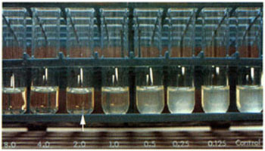
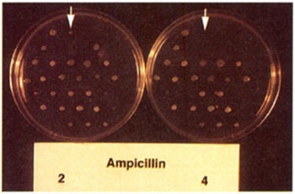
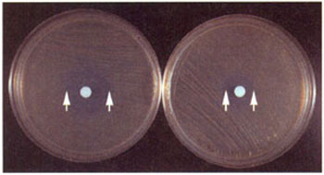
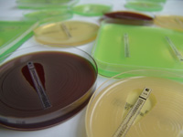
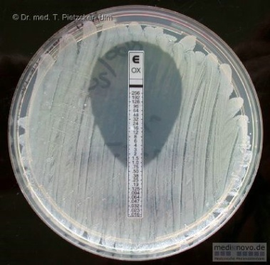
Susceptibility Test Methods
Broth Dilution
Agar dilution:
disk diffusion (KB)
Etest® (Biomerieux).

Slide 18
Blood culture processes

Slide 19
Growth is required for phenotypic identification and antibiotic susceptibility testing 鉴定，药敏依赖于生长
Growth rates vary significantly among different organisms
  生长速度差异

Slide 20
Bacterium generation time - variable
E. coli 大肠杆菌: 20 - 30 minutes (visible colonies can be observed after overnight or 1 day of incubation)
Mycobacteria 分枝杆菌: up to 20 hours. (M. ulcerans, 36 h)

Slide 21
Assay turnaround time
- standard culture based methods
Bacterial culture: 1-3 days
Mycobacterial culture: 6-8 weeks
Fungal culture: 4 weeks
Virus culture: 2 weeks (2 days for shell vial culture)

Slide 22
Impact (MALDI-TOF and real-time alert)
(Huang et al. 2013 CID)
Setting: 501 adults; bacteremia and candidemia hospitalized; Gram pos, neg, and yeasts.
Lab testing: BacT/Alert + VITEK-2;
Stewardship team intervention: no change between pre- and study period
Study period:
  (1) MALDI-TOF identification added 质谱病原鉴定;
  (2) real-time electronic alert of organism Gram stain, ID, AST to the Stewardship team (6:00 AM- 11:30 PM), plus email 24 h/d 实时抗生素咨询指导委员会管理.

Slide 23
Impact (MALDI-TOF and real-time alert)
(Huang et al. 2013 CID)

Slide 24
Impact (MALDI-TOF, Rapid AST, and stewardship)
(Parez et al. 2012. Arch Pathol Lab Med)
Setting: 201 adults; bacteremia; Gram neg rods only
Lab testing: BACTEC + Phoenix; （成人，菌血症，革兰氏阴性菌）
Study period:
  (1) MALDI-TOF identification added;质谱鉴定
  (3) Rapid susceptibility testing 快速药敏
  (2) Near-real-time Stewardship intervention 实时抗生素咨询指导委员会管理

Slide 25
(Parez et al. 2012. Arch Pathol Lab Med)

Slide 26
Impact (MALDI-TOF, Rapid AST, and stewardship)
(Parez et al. 2013. Arch Pathol Lab Med)

Slide 27
Lurie Children’s: positive blood culture
4/2012 – 4/2013
E. coli: 23
Klebsiella spp: 23
  K. pneumoniae = 18
  K. oxytoca = 5
Pseudomonas spp: 14
  Ps. aeruginosa = 13

Slide 28
Lurie Children’s
Gram negative rods: PNA FISH （DNA原位杂交染色鉴定） for differentiation of E. coli vs. pseudomonas aeruginosa (大肠杆菌，绿脓杆菌绿 3-4 hours)
Yeast: PNA FISH for Candida albicans and C.
Gram positive organisms:
    Verigene BC-GP (2.5 hours)

Slide 29
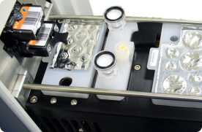
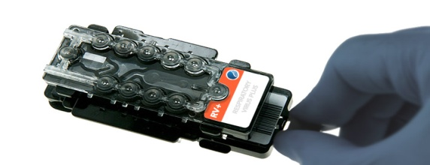
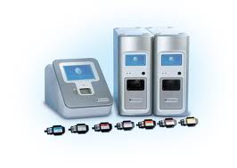
Verigene system by Nanosphere
Target
Staph genus
S. aureus
S. epi
S. lugdunesis
Strep spp.
GAS
GBS
S. pneumo
S. anginosus
Enterococcus spp.
E. faecalis
E. faecium
Listera
mecA
vanA/B

Slide 30
Evaluation of Verigene Gram-positive blood culture rapid DNA test: ID= 1 day earlier; sens= 1-2 day earlier

Slide 31
Lurie Children’s data
Bacterium | BC-GP vs. culture | BC-GP sensitivity
Staphylococcus aureus | 35/35 | 100%
Enterococcus species | 13/13 | 100%
Streptococcus pneumoniae | 2/2 | 100%
Staphylococcus epidermidis | 19/24 | 79%
Other species of CNS | 11/13 | 85%
Streptococcus mitis/ovalis | 5/5 | 100%
Streptococcus salivarius | 2/3 | 67%
Bacterium | BC-GP vs. culture | BC-GP sensitivity
Staphylococcus aureus | 35/35 | 100%
Enterococcus species | 13/13 | 100%
Streptococcus pneumoniae | 2/2 | 100%
Staphylococcus epidermidis | 19/24 | 79%
Other species of CNS | 11/13 | 85%
Streptococcus mitis/ovalis | 5/5 | 100%
Streptococcus salivarius | 2/3 | 67%

Slide 32
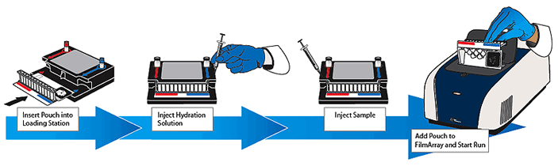
FilmArray
（实时，多重，自动PCR）
Detects Gram positive, Gram negative, and Candida species

Slide 34
FilmArray Blood Culture ID Panel
Gram-negative bacteria
Acinetobacter baumannii
Haemophilus influenzae
Neisseria meningitidis
Pseudomonas aeruginosa
Enterobacteriaceae
  Enterobacter cloacae complex
  Escherichia coli
  Klebsiella oxytoca
  Klebsiella pneumoniae
  Proteus
  Serratia marcescens
Yeast
Candida albicans
Candida glabrata
Candida krusei
Candida parapsilosis
Candida tropicalis
Antimicrobial resistance genes
mecA - methicillin resistance
vanA/B - vancomycin resistance
KPC - carbapenem resistance

Slide 35
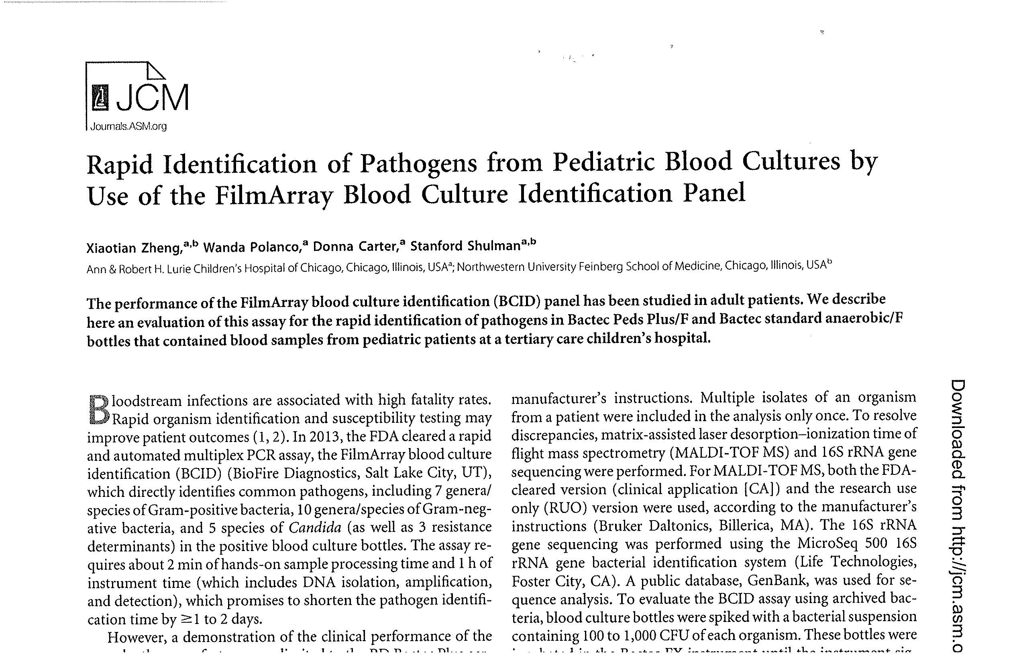
Pathogen | # recovered by culture | # BCID identified (%) | # organisms recovered by culture, not included in the BCID assay | # organism recovered by culture intended to be identified by BCID but missed | Recovery of organisms included in the BCID assay (%)
Gram positive bacteria | 122 | 112 (91.8%) | 6 | 4 | 96.6%
Gram negative bacteria | 58 | 50 (86.2%) | 6 | 2 | 96.2%
Candida | 8 | 6 (75%) | 1 | 1 | 85.7%
Total | 188 | 168 (89.4%) | 13 | 7 | 96%

Slide 36
Direct Inoculation Method for Identification and Susceptibility testing
阳性血培养直接鉴定，药敏
Literature | Blood culture | Broth preparation | Identification | Susceptibility testing | Performance (ID) | Performance (Sens)
Gherardi et al, DMID, 2012 | Bactec | 8 ml, spin x 2 | Vitek-2 Compact | Vitek-2 Compact | GN = 100%; GP = 75%%; | GN = 99%; GP = 96%
 |  |  | Phoenix | Phoenix | GN = 92%; GP = 44% | GN = 99%; GP = 99%
Yonetani et al, DMID, 2012 | BacT/ ALERT | 12 ml, Serum Separator Tubes | Phoenix | Phoenix | GN = 97%; GP = 89% | GN = 91-99%; GP = 92%

Slide 37
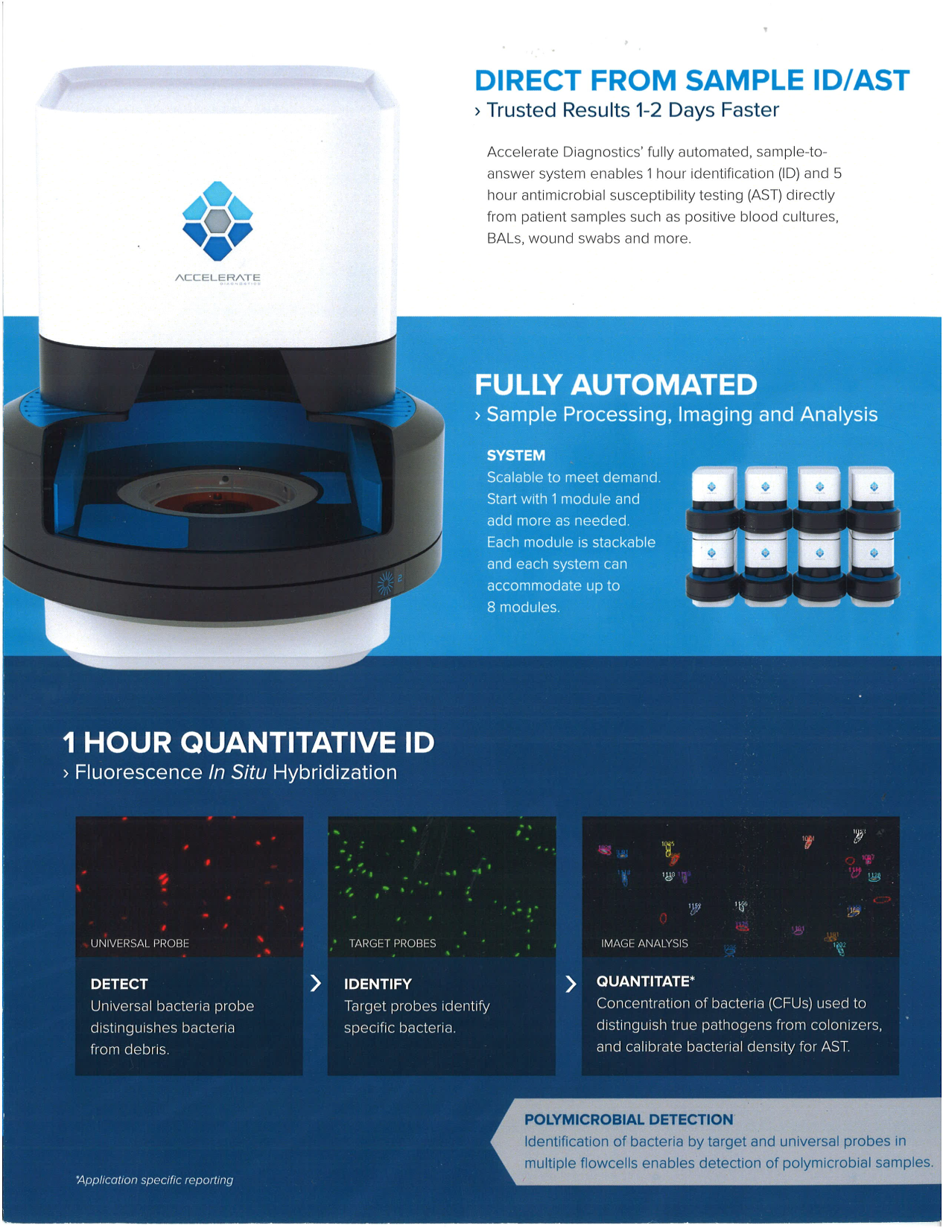

Slide 38
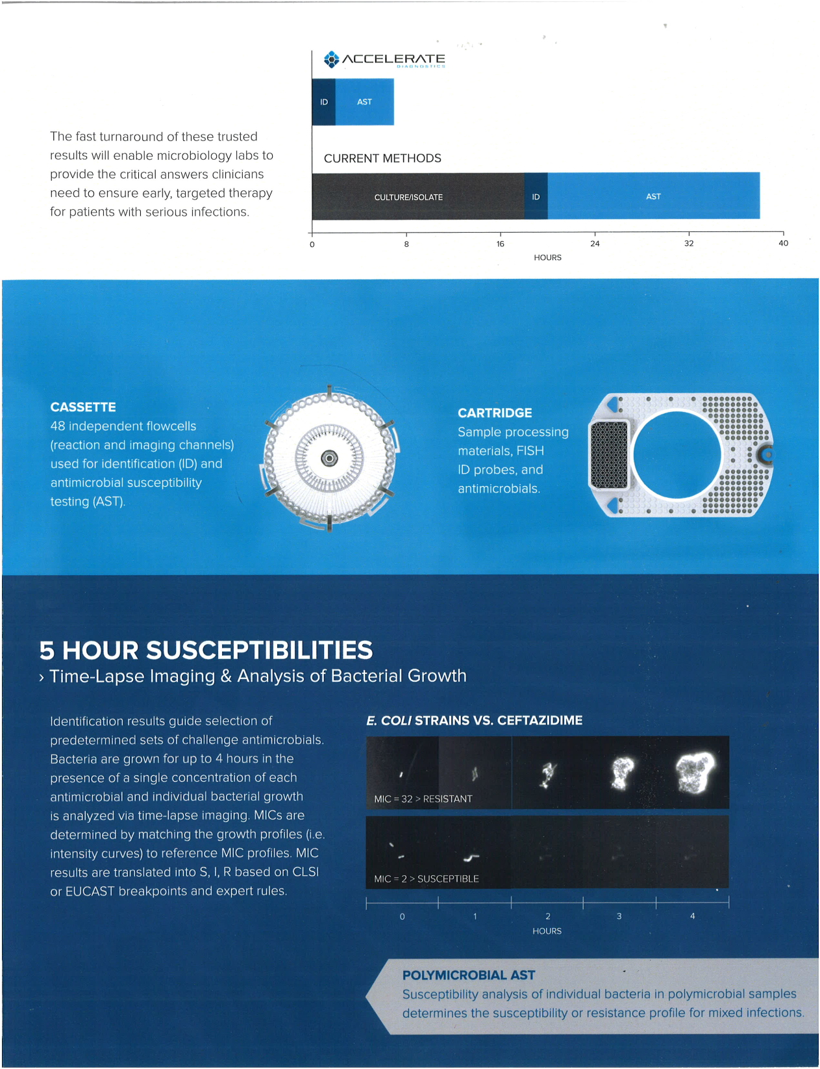

Slide 39
Lurie Children’s
PCR： B. pertussis 百日咳， HSV单疱病毒， Enterovirus 肠病毒
Rapid antigen detection for
  Trichomonas vaginalis : 阴道滴虫
  Malaria: 疟疾
  Group A Strep on pleural fluids
  Other molecular assays that improved rapid results:
    Virus load for CMV, EBV, BK virus,
    Other pathogens: Adenovirus, CT/NG, MRSA, C. difficile, and Respiratory panel

Slide 40
Isolation, Gram stain, S. pyogenes PCR and rapid antigen test results for 120 pleural fluids from pediatric patients.

Slide 41
Group A Streptococcus DNA detection by LAMP

Slide 42
Clinical significance
Both superficial and deep infections
pharyngitis 急性咽炎
impetigo 化脓性脓疱病
sepsis 败血症
cellulitis
necrotizing fasciitis
etc.
Complications: glomerulonephritis 肾小球肾炎 and rheumatic fever 风湿热

Slide 43
Acute pharyngitis caused by GAS
急性咽炎
Accounts for 15 – 30% of cases in children 儿童
5 – 10% in adults 成人.
Laboratory diagnosis assists differentiation from viral caused infections.
早期诊断治疗：
antibiotic therapy which prevents sequelae of rheumatic fever and acute glomerulonephritis 抗生素治疗预防风湿热
等后遗症,
reduces acute morbidity 控制发病, and
limits transmission to contacts 限制传播.

Slide 44
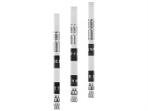
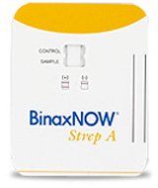
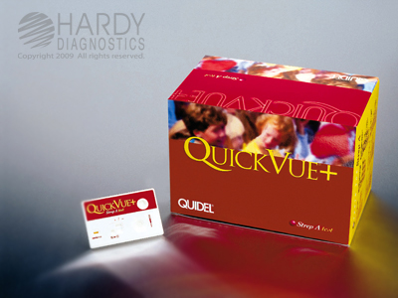
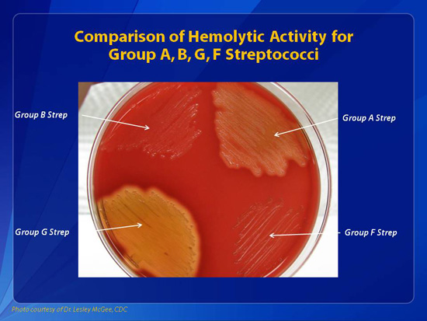
Standard Testing
1. Rapid Ag 快速抗原检测: Fast, easy to perform, but performances highly variable; 70-80% sensitivity 敏感性不够
Culture 培养: “gold standard”? 1-2 days.

Slide 45
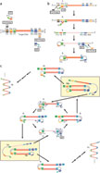
Loop-mediated isothermal amplification
(LAMP) technology 等温扩增
Highly specific 高特异性: uses multiple primers that recognize various regions on the target DNA.
It can be used for both DNA and RNA targets (RT-LAMP).
Fast: (~60 min) in one step 检测时间= 1 小时
Thermocycler is not needed 无需贵重仪器
Detection: A by-product of this amplification is the formation of magnesium pyrophosphate, which forms a white precipitate leading to a turbid reaction solution. This presence of turbidity signifies a positive reaction while the absence of turbidity represents a negative reaction.
http://www.nature.com/nprot/journal/v3/n5/full/nprot.2008.57.html#f1

Slide 46
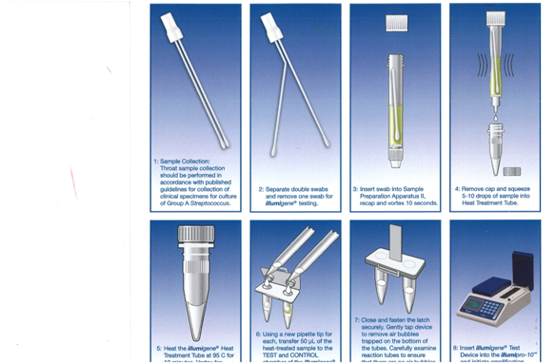
Total time needed: 1 hour

Slide 47
Table 1. Comparison of illumigene® results to culture on 437 consecutive specimens

Slide 48
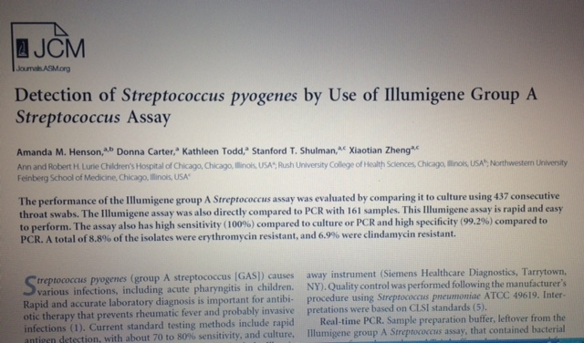
可取代培养
Sensitivity = 100%
Specificity = 99.2%

Slide 49
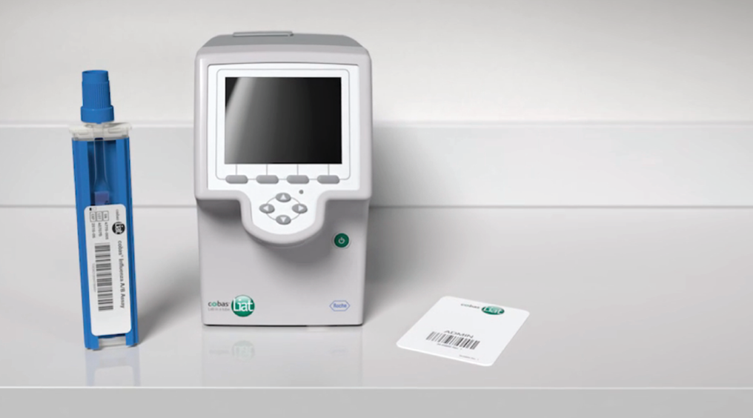
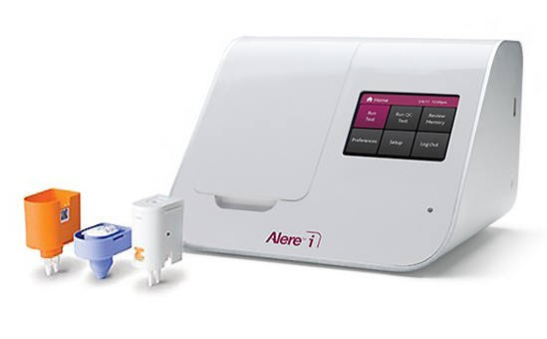
Cobus Liat by Roche
Alere™ I
Technology: isothermal nucleic acid amplification
Manu: influenza A/B (15’); GAS (8’)
Technology: real time PCR
Manu: influenza A/B (25’); GAS (20’)

Slide 50
并非所有快速检测都有效
脑脊液快速细菌抗原检测:
敏感性接近革兰氏染色
阳性结果对治疗无明显影响
假阳性结果：对治疗无益，但延长住院，参加医疗费用
  (Perkins et al, 1995. JCM 33:1486-1491)

Slide 51
Rapid antigen detection assays for respiratory viruses
呼吸道病毒的快速抗原检测
Low sensitivity and marginal specificity （低敏感性，特异性也不高
Considerations:
  inappropriate antibiotic use (cost and resistance)不合理抗生素使用导致耐药，增加治疗费用,
  length of hospital stay 延长不必要的住院时间,
  ancillary testing due to the lack of a diagnosis 增加更多的诊断, and
  potential for transmission to other patients 传播
(Ginocchio and McAdam. 2011. JCM S44-48)

Slide 53

Community-Acquired Pneumonia Requiring Hospitalization among U.S. Children
美国儿童需住院治疗的社区感染的肺炎
Seema Jain, M.D., Derek J. Williams, M.D., M.P.H., Sandra R. Arnold, M.D., Krow Ampofo, M.D., Anna M. Bramley, M.P.H., Carrie Reed, Ph.D., Chris Stockmann, M.Sc., Evan J. Anderson, M.D., Carlos G. Grijalva, M.D., M.P.H., Wesley H. Self, M.D., M.P.H., Yuwei Zhu, M.D., Anami Patel, Ph.D., Weston Hymas, M.S., James D. Chappell, M.D., Ph.D., Robert A. Kaufman, M.D., J. Herman Kan, M.D., David Dansie, M.D., Noel Lenny, Ph.D., David R. Hillyard, M.D., Lia M. Haynes, Ph.D., Min Levine, Ph.D., Stephen Lindstrom, Ph.D., Jonas M. Winchell, Ph.D., Jacqueline M. Katz, Ph.D., Dean Erdman, Dr.P.H., Eileen Schneider, M.D., M.P.H., Lauri A. Hicks, D.O., Richard G. Wunderink, M.D., Kathryn M. Edwards, M.D., Andrew T. Pavia, M.D., Jonathan A. McCullers, M.D., Lyn Finelli, Dr.P.H., for the CDC EPIC Study Team
N Engl J Med
Volume 372(9):835-845
February 26, 2015

Slide 54
Study Overview
Pneumonia is a major cause of severe illness in children.
In a study of community-acquired pneumonia requiring hospitalization among U.S. children, those younger than 2 years of age were most affected, and viruses were most commonly found.

Slide 55
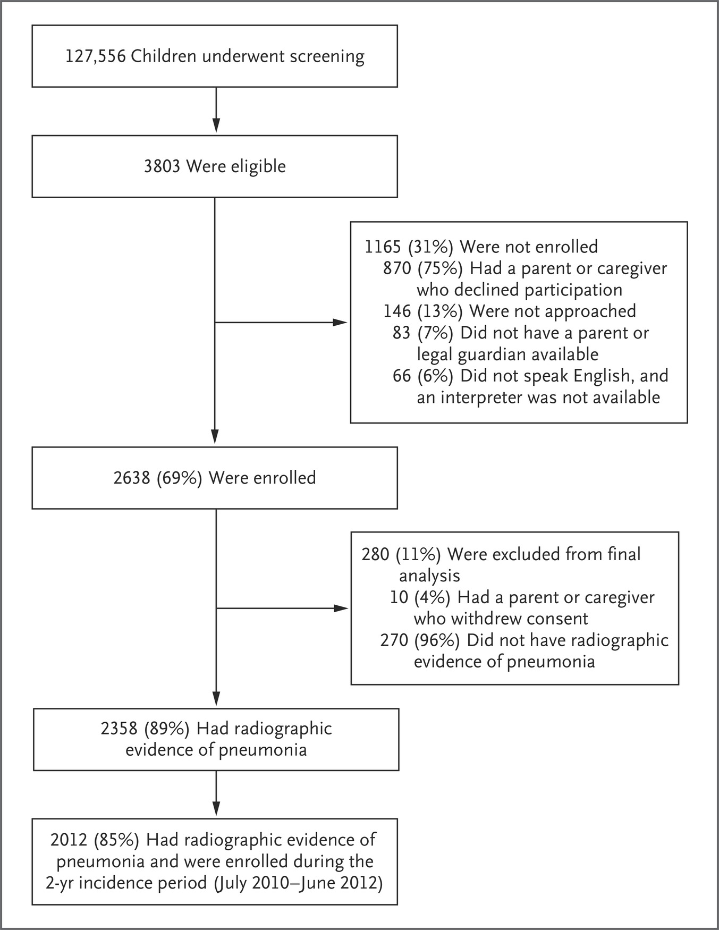
Screening, Eligibility, and Enrollment of Children with Pneumonia.
Jain S et al. N Engl J Med 2015;372:835-845
Notes:
Figure 1 Screening, Eligibility, and Enrollment of Children with Pneumonia. A total of 2354 children had chest radiographs that met the radiographic inclusion criteria of consolidation, infiltrate, or effusion. One child had only a computed tomographic (CT) scan available that met the criteria for radiographic evidence of pneumonia. A total of 3 children did not have evidence of pneumonia on the basis of chest radiography but did have evidence of pneumonia on the basis of available CT scans. A total of 99% of the radiographs were obtained within 48 hours before or after admission.

Slide 56
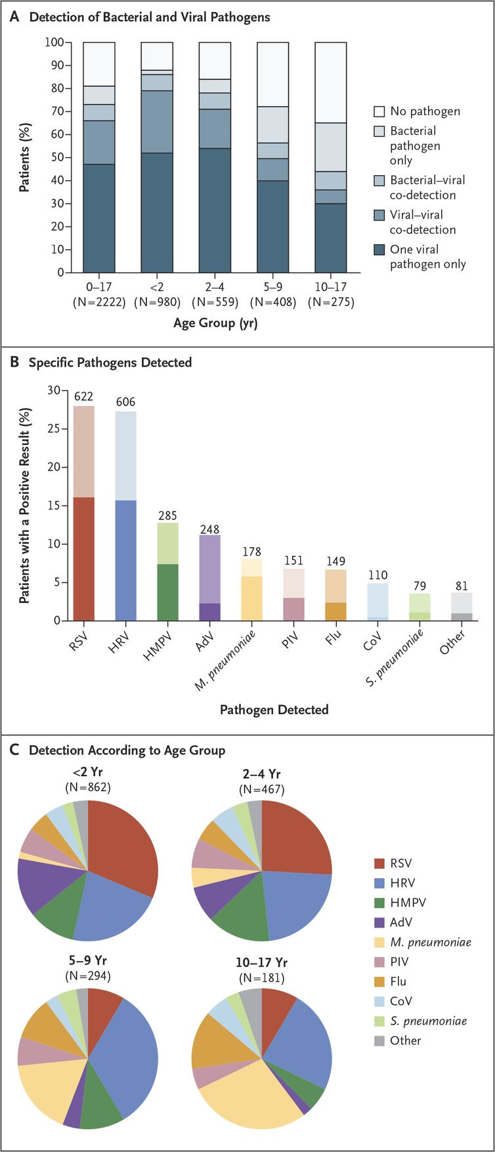
Pathogens Detected in U.S. Children with Community-Acquired Pneumonia Requiring Hospitalization.
Jain S et al. N Engl J Med 2015;372:835-845
Notes:
Figure 2 Pathogens Detected in U.S. Children with Community-Acquired Pneumonia Requiring Hospitalization. Panel A shows the proportion of pathogen types detected from January 1, 2010, through June 30, 2012, among 2222 hospitalized children with radiographic evidence of pneumonia who had blood samples or pleural fluid available for bacterial culture or real-time polymerase-chain-reaction (PCR) assays or endotracheal aspirate or bronchoalveolar-lavage specimens available for bacterial culture and who also had nasopharyngeal or oropharyngeal swabs available for viral and atypical bacterial PCR assay or available viral serologic results. A total of 4 patients had more than one bacterial pathogen without a virus detected. Panel B shows the numbers (above the bars) and percentages of all children in whom a specific pathogen was detected. Among 2222 patients who had available tests for the detection of bacterial and viral pathogens, 1802 were found to have a viral or bacterial pathogen (or both). Because more than 1 pathogen could be detected in a patient, there were a total of 2533 pathogens detected. A total of 88 pathogens other than those listed here were detected in 81 children, including Staphylococcus aureus (in 22 children, of whom 17 had methicillin-resistant S. aureus and 5 had methicillin-susceptible S. aureus), Streptococcus pyogenes (in 16), viridans streptococci (in 14), Chlamydophila pneumoniae (in 12), Haemophilus influenzae (in 9), other gram-negative bacteria (in 9), other streptococcus species (in 4), and histoplasma (in 2). Darker shading in the bar graph in Panel B indicates that only the single pathogen was detected, and lighter shading indicates the pathogen was detected in combination with at least one other pathogen. AdV denotes adenovirus, CoV coronavirus, Flu influenza A or B virus, HMPV human metapneumovirus, HRV human rhinovirus, PIV parainfluenza virus, and RSV respiratory syncytial virus. Panel C shows the proportions of pathogens detected, according to age group.

Slide 57
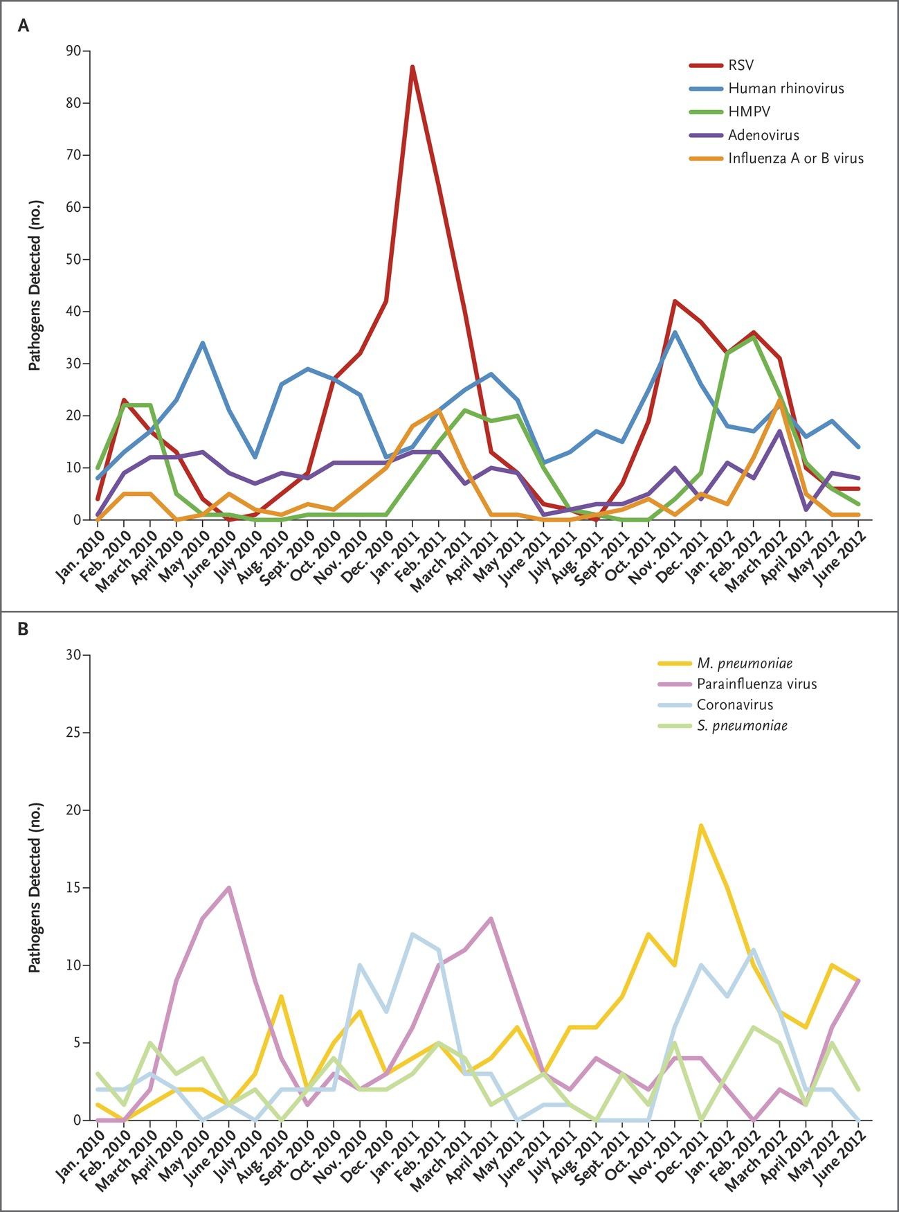
Pathogens Detected, According to Month and Year, in U.S. Children with Community-Acquired Pneumonia Requiring Hospitalization, January 1, 2010, through June 30, 2012.
Jain S et al. N Engl J Med 2015;372:835-845
Notes:
Figure 3 Pathogens Detected, According to Month and Year, in U.S. Children with Community-Acquired Pneumonia Requiring Hospitalization, January 1, 2010, through June 30, 2012.

Slide 58
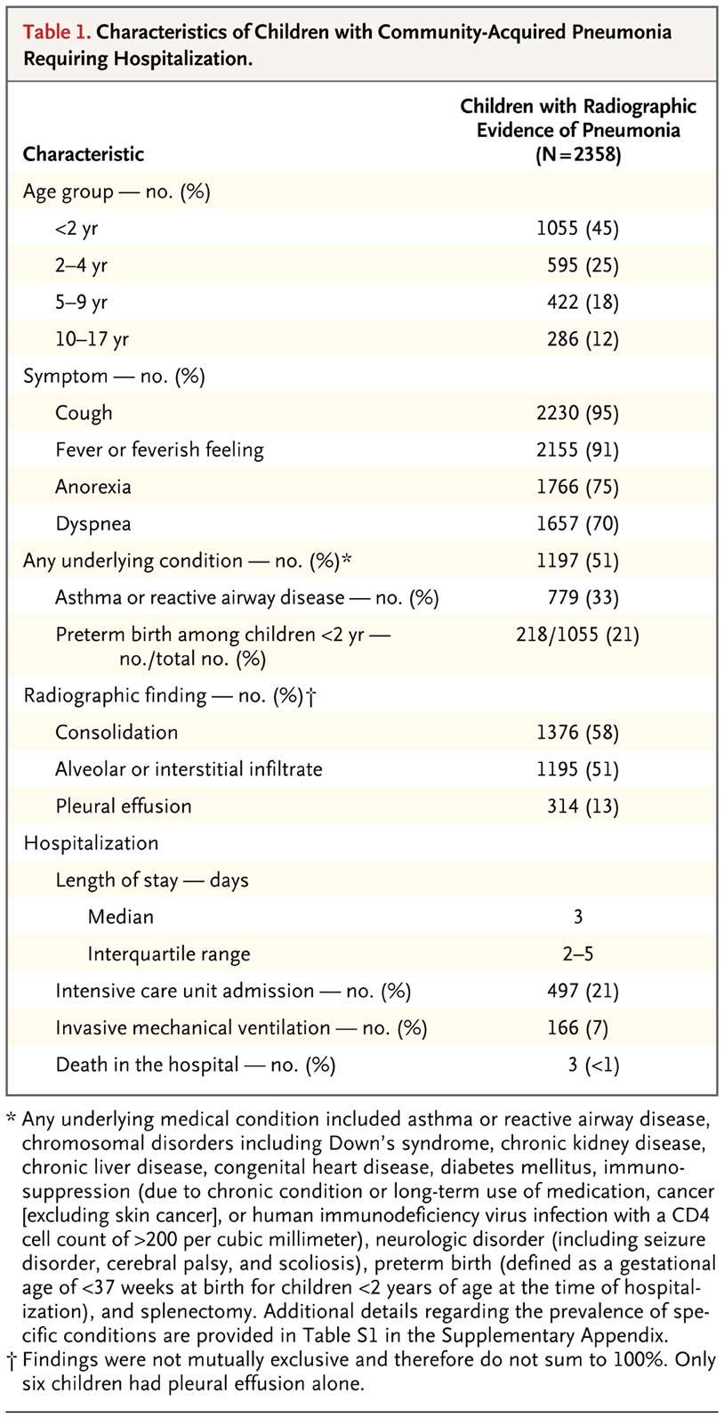
Characteristics of Children with Community-Acquired Pneumonia Requiring Hospitalization.
Jain S et al. N Engl J Med 2015;372:835-845
Notes:
Table 1 Characteristics of Children with Community-Acquired Pneumonia Requiring Hospitalization.

Slide 59
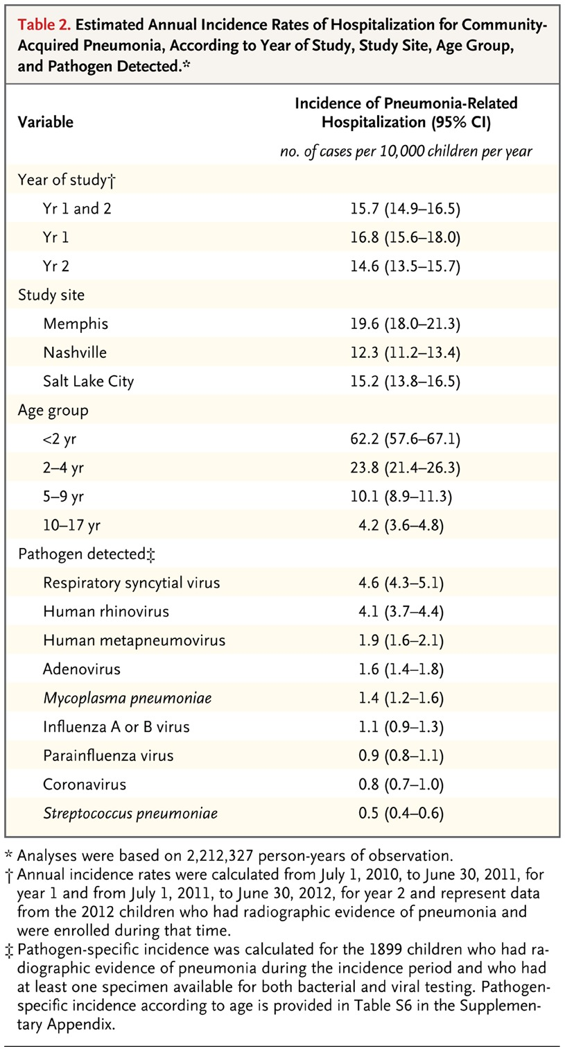
Estimated Annual Incidence Rates of Hospitalization for Community-Acquired Pneumonia, According to Year of Study, Study Site, Age Group, and Pathogen Detected.
Jain S et al. N Engl J Med 2015;372:835-845
Notes:
Table 2 Estimated Annual Incidence Rates of Hospitalization for Community-Acquired Pneumonia, According to Year of Study, Study Site, Age Group, and Pathogen Detected.

Slide 60
Respiratory pathogen detection
Bacteria
Viruses
Fungal pathogens

Slide 61
Conclusions
The burden of hospitalization for children with community-acquired pneumonia was highest among the very young, with respiratory viruses the most commonly detected causes of pneumonia.
美国儿童需住院治疗的社区感染的肺炎： 最高发于低年龄儿童； 呼吸道病毒是最常见的病原

Slide 62
Benefits of Rapid Detection of Respiratory Viruses
(JCM, ‘2000,38:2824)

Slide 63
快速呼吸道病毒检测
有利于及时的针对病原的治疗 （如流感病毒）
减少不需要的抗生素使用 （特别是免疫低下病人）
减少不需要的其他诊断检测 （影像；腰穿； 等）
确保有效医院感控管理
减少住院及医疗总开销
提高病人满意度

Slide 64

我所在医院检测呼吸道病毒方法
流感病毒A/B和呼吸道合包病毒（实时PCR）：用于门诊，非住院病人
呼吸道多重病原检测（实时多重PCR）：用于免疫低下（移植，肿瘤）；重症病人（PICU，NICU，CCU）
时间：全天24 小时
回报：平均1.5 小时

Slide 65
Respiratory virus testing report

Slide 72
Summary
Rapid microbiology testing and reporting improve patient care 快速微生物学检测提高诊治效果
New technologies help improve test performances while shortening time 新技术的应用提高诊断，缩短时间
Thorough understanding of clinical needs and assay characteristics are essential for assay selection and implementation 丰富的临床知识和对实验的正确理解， 对于实验选择和结果报告至关重要

